Slide 1
Coordinate system Transformation
Elaborated and scripted by Mahdi abdrahmen Madi M1 TPT

Slide 2
01
A brief introduction to coordinates systems
Why is it necessary to transform coordinates from geographic to projected system ?
02
Table of Content
03
Application
04
Final thoughts

Slide 3
Our Workflow
Addressing the problem and why is it necessary to transform coordinates ?
Understanding the methods behind transforming coordinates
Converting those methods to scripts
Simplify the scripts used as much as possible

Slide 4
The earth Radius
definition
Is the distance from the center of the earth to a point on or near its surface
Polar radius
A minimum radius of nearly 6,357km denoted b
Equatorial radius
A maximum radius of nearly 6,378km denoted a
The global average value
is usually considered to be 6,371km

Slide 5
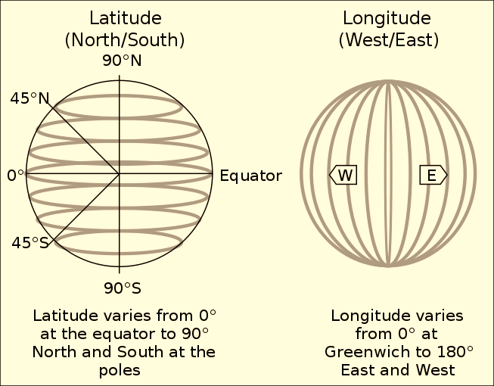
The Geographic coordinate system (GCS)
is a spherical or ellipsoidal coordinate system for measuring and communicating positions directly on the earth as latitude and longitude It is the simplest, oldest and most widely used of the various of spatial reference systems that are in use and forms the basis for most others. Although latitude and longitude form a coordinate tuple like a cartesian coordinate system, the geographic coordinate system is not cartesian because the measurements are angles and are not on a planar surface

Slide 6
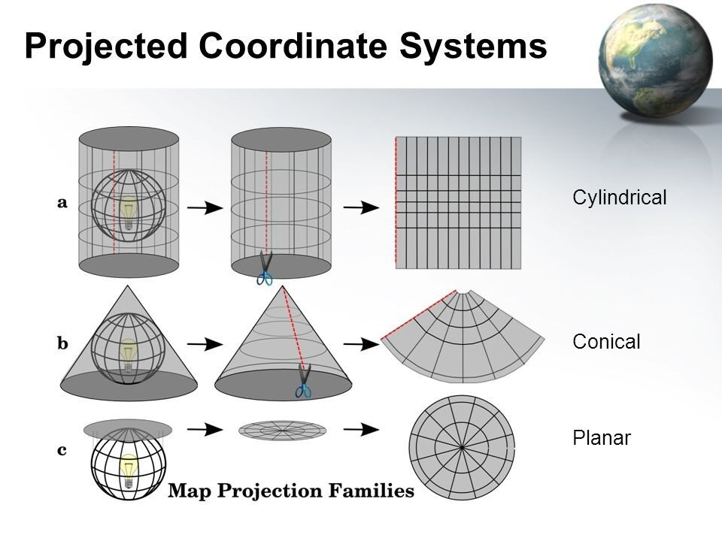
The Projected coordinate system (PCS)
A projected coordinate system is defined on a flat, two-dimensional surface, has constant lengths, angles, and areas across the two dimensions. A PCS is always based on a GCS that is based on a sphere or spheroid.
In a PCS, locations are identified by x,y coordinates on a grid, with the origin at the center of the grid. Each position has two values that reference it to that central location. One specifies its horizontal position and the other its vertical position. The two values are called the x-coordinate and y-coordinate. Using this notation, the coordinates at the origin are x = 0 and y = 0.

Slide 7
Addressing the issue :
Why is it necessary to convert coordinates from geographic
to projected ?

Slide 8
To put it simply..
Geographic coordinate system (GCS)
Defines where the data is located on the earth’s surface
Projected coordinate system (PCS)
Tells us how to draw the earth on a flat surface
Geographic coordinate system
Is round (3D) and records locations in angular units (usually in degrees)
Projected coordinate system
Is flat (2D) and records locations in linear units (usually in meters)

Slide 9
About this script
Convert cartesian to angular lat/lon coordinates
Convert great circle distance to spherical arc length
Convert angular to cartesian coordinates
Convert spherical arc length to great circle distance
Call for the user input depending on the need

Slide 10
Geographic to
Projected coordinates system
This function allows conversions from angular to cartesian coordinates
def latlon_to_xyz (lat,lon) :
Declaring a new function latlon_to_xyz where :
lat = latitude and lon = longitude are its variables
R = 6371
Earth radius in meters
Theta = math.pi/2 – math.radians(lat)
Polar angle
Phi = math.radians(lon)
Azimuthal angle

Slide 11
Geographic to
Projected coordinates system
X = r * math.cos(theta) * math.cos(phi)
the x-axis goes through long,lat (0,0), so longitude 0 meets the equator
Y = r * math.sin(theta) * math.cos(phi)
the y-axis goes through (0,90)
Z = r * math.sin(theta)
and the z-axis goes through the poles.
Return [x,y,z]
Output in meters

Slide 12
Projected to
Geographic coordinates system
Convert cartesian to angular lat/lon coordinates
def = xyz_to_latlon (x,y,z) :
Declaring a new function xyz_to_latlon
where : lat and lon are its variables
R = math.sqrt(x**2 + y**2 + z**2)
Radial distance
Theta = math.asin(z/r)
Polar angle
Phi = math.atan2(y,x)
Azimuthal angle

Slide 13
Projected to
Geographic coordinates system
lat = math.degrees(theta)
latitude is the 90deg - zenith angle in range [-90°;90°]
lon = math.degrees(phi)
longitude is the azimuthal angle in range [-180°;180°]
return [lat,lon]
Output of xyz_to_latlon function as latitude,longitude

Slide 14
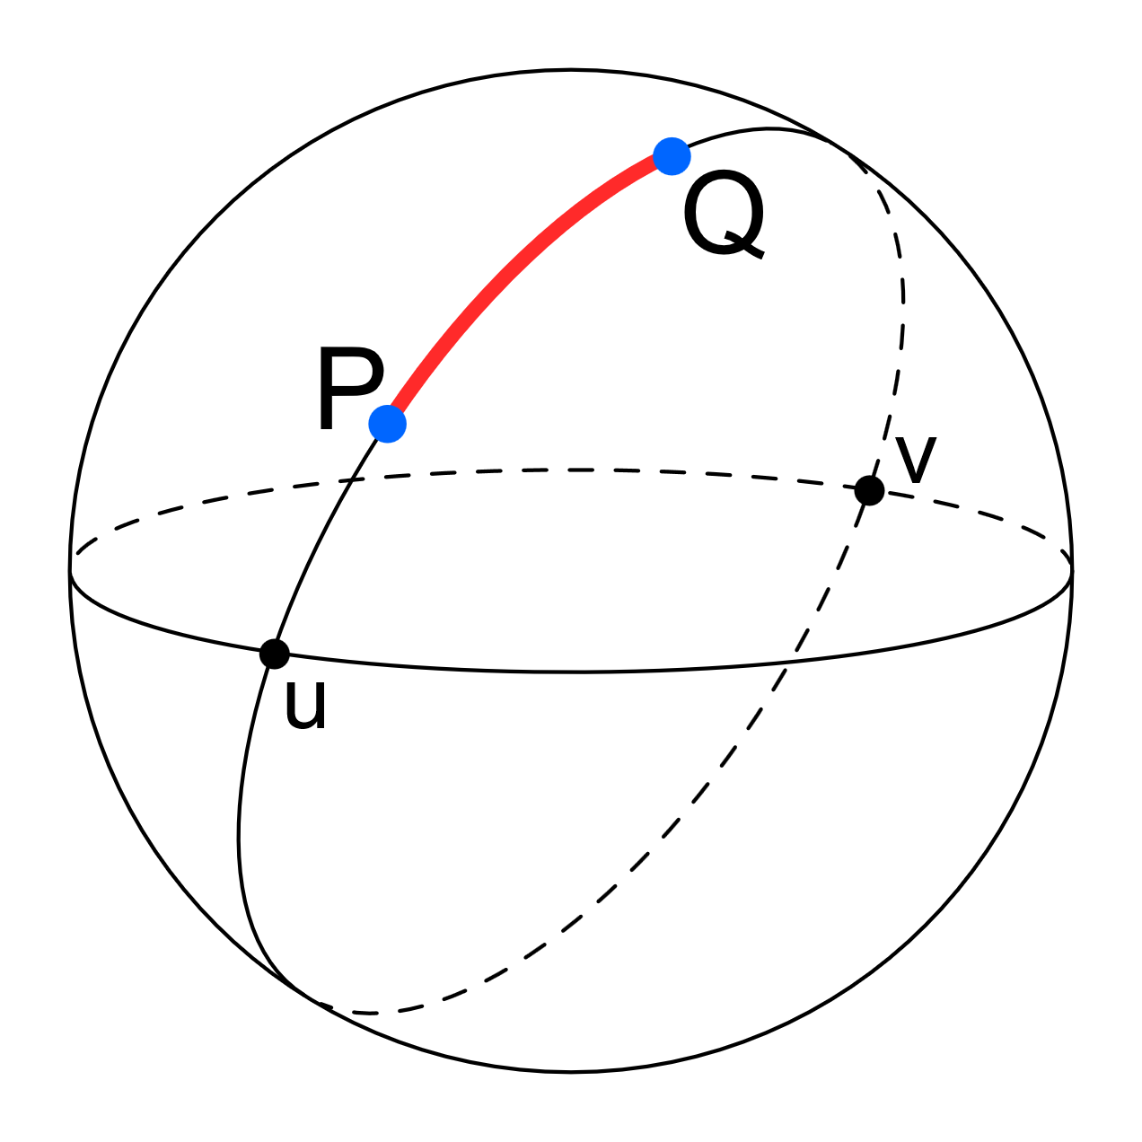
Convert Spherical arc length[m]
To Great circle distance[deg]
def arc_to_deg (arc)
Declaring a new function named arc_to_deg where arc is its variable
return float(arc)/6371/1000 * 180/math.pi
Returns great circle distance in degrees

Slide 15
Convert Great circle distance[deg] To Spherical arc length[m]
def deg_to_arc (deg)
Declaring a new function named deg_to_arc where deg is its variable
return float(deg)*6371*1000 * math.pi/180
Returns spherical arc length in meters

Slide 16
Alignment
A
T
Transferring data
The coordinates transformations (from GCS to PCS) allows data to be perfectly aligned when going from a 3D model to a 2D flat surface
However, when transferring data, it is best advised to convert coordinates back to GCS
Final thoughts
Measurements
M
L
Location accuracy
Accurate measurements when using spatial analyst tools such as measuring distances, angles, shapes and directions
And If you won’t be performing queries based on location and distance, GCS can still get the job done

Slide 17
Thank You
see more about this project on GitHub click here

